Slide 1
MIS775- Decision Modelling for Business Analytics
ASSIGNMENT 2
STOCHASTIC DECISION MODELS
Prepared by
Group A2 90
Vikas Gupta Varkey Joseph Vettoor Gurjas Singh
ID: 218509363 ID: 216060926 ID:218662404

Slide 2
MODEL DESCRIPTION
OBJECTIVE
To develop a spreadsheet-based decision model and analyse the financial risks Mr Sabat Urda might face if he takes out a small business loan in order to expand his Coffee Roastery and Bakery business. The model would enable Sabat to input the loan size, the loan term, and the percentage of net profit that will be set aside each week for meeting the loan repayments at the end of every fourth week.
METHODOLOGY
Historical financial data for his premises, covering costs and sales revenue each week over three years was provided and used to set-up the model.
SCOPE OF WORK
The following will be the deliverables of this project
Model description, conceptual model and a list of assumptions
Spreadsheet based decision model that has the relevant fixed inputs, stochastic inputs ( have random variation), decision variables, calculated variables and output variables

Slide 3
MODEL DESCRIPTION
SCOPE OF WORK CONT’D
Scenario and Sensitivity Analysis Reports depicting the impact of stochastic inputs and decision variables on the outputs. Here different scenarios of the stochastic inputs and decision variables would be considered.
Stochastic modelling including choice of distributions to identify and fit the appropriate probability distributions to the stochastic inputs based on the given historical data.
Simulated output distribution and risk analysis report based on simulation modelling in order to quantify the risks associated with meeting the loan commitments.
Overall presentation of all deliverables.

Slide 4
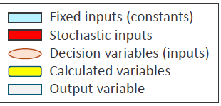
Conceptual Model
Term of the Loan
Loan size
Sales Revenue
Net Profit
Is Sabat in default or not?
Total Costs
Required Repayment of the loan
Extra revenue generated due to the the loan (25%)
Extra cost incurred due to the the loan (25%)
Money set aside for meeting loan repayment
Percentage of net profit for loan repayment
Interest rate per installment
Interest Rate
Leasing
Number of installments
Utilities
Phone & Internet
Baking Supplies
Coffee Supplies
Insurance
Regular Maintenance& Cooking Appliance
General Consumables
Ad-hoc maintenance
Regular Maintenance& Coffee Machine
Other costs
Total Staff Wages
Sabat’s Wage
Percentage of extra revenue per dollar of loan amount
No of installments per year
Percentage of extra cost per dollar of loan amount

Slide 5
MODEL Assumptions
The following is a list of the key model assumptions.
The term of the loan is limited to one, two, or three years.
Equal loan repayments are made every four weeks, covering both principal and interest. The repayments must be met immediately following the end of each four week period. Otherwise Sabat will be deemed in default of the loan agreement.
Sabat plans to set aside a fixed percentage of his profit in each four-week period, and use that money to cover the loan repayment due at the end of each period.
There is no option for making extra repayments on the loan.
Assume that Sabat has no other income to rely on should he have set aside insufficient funds to meet a repayment.
Sabat is correct in his belief regarding the additional revenue generated and increased costs associated with taking out a loan and this will be applied to the principal loan amount split equally among the repayment period.
Your decision model needs to take into account the costs of running the business and the sales revenue in order to determine the profit generated in each four-week period. You will use it to explore the risks associated with Sabat taking the loan under various scenarios of your choosing.

Slide 6
MODEL Assumptions
For section 3 (Scenario and Sensitivity analysis reports)
Repayment will comprise of the principal component which is the loan amount equally divided into installments to be paid every 4 weeks based on term of the loan plus the interest component ( Interest rate per month multiplied by principal amount.
The most recent RBA interest rate (Lending rates; Small business; 3-year fixed) 4.27% for December 2019 will be used as the per annum rate. This will be divided by number of installments to calculate interest rate to be applied on the repayment amount.

Slide 7
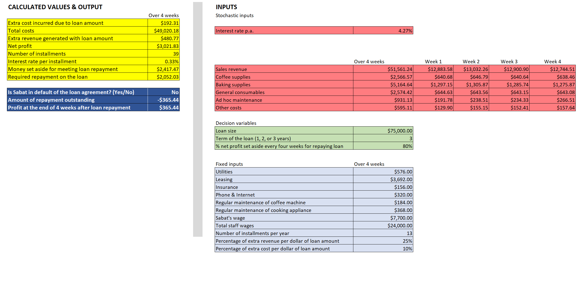
Spreadsheet BASED decision Model

Slide 8
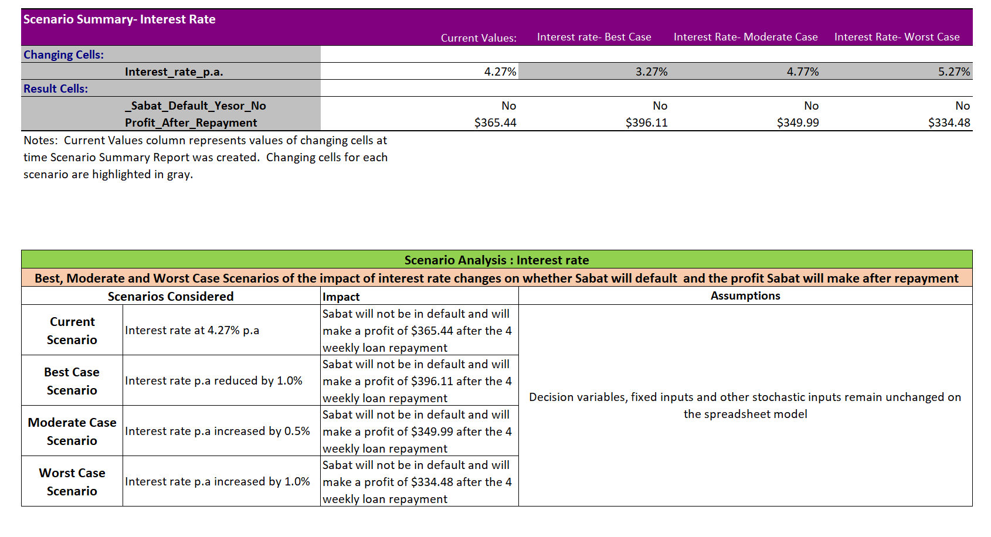
Scenario analysis

Slide 9
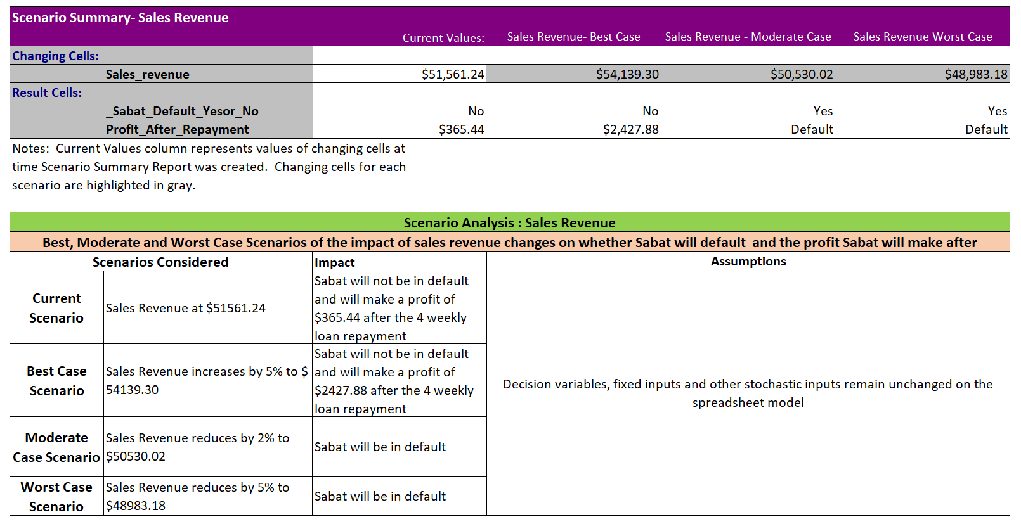
Scenario analysis

Slide 10
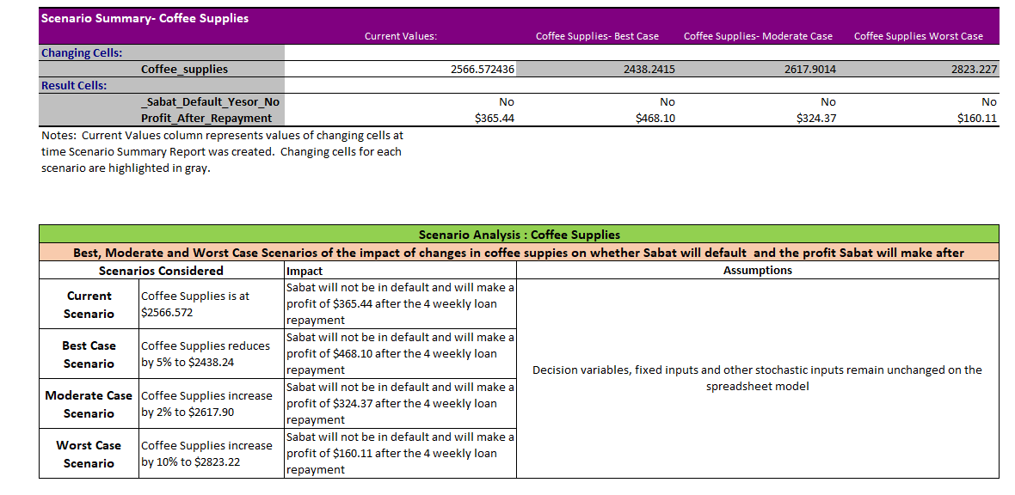
Scenario analysis

Slide 11
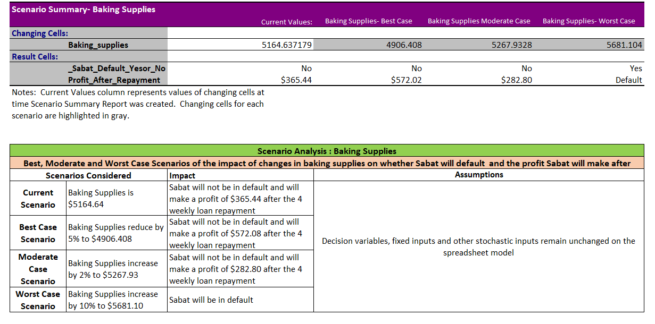
Scenario analysis

Slide 12
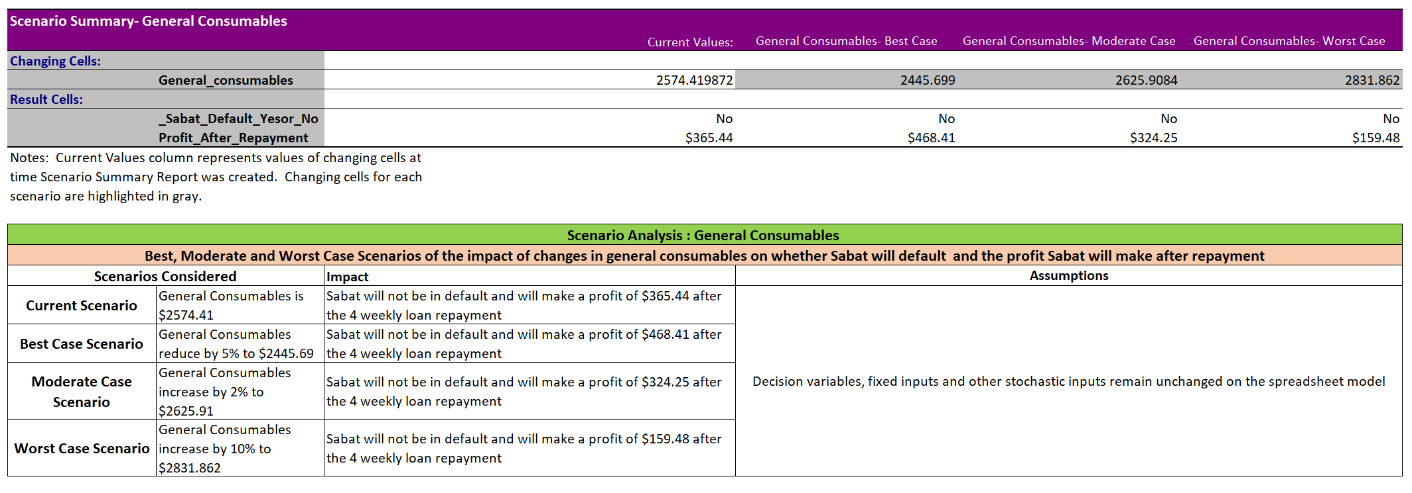
Scenario analysis

Slide 13
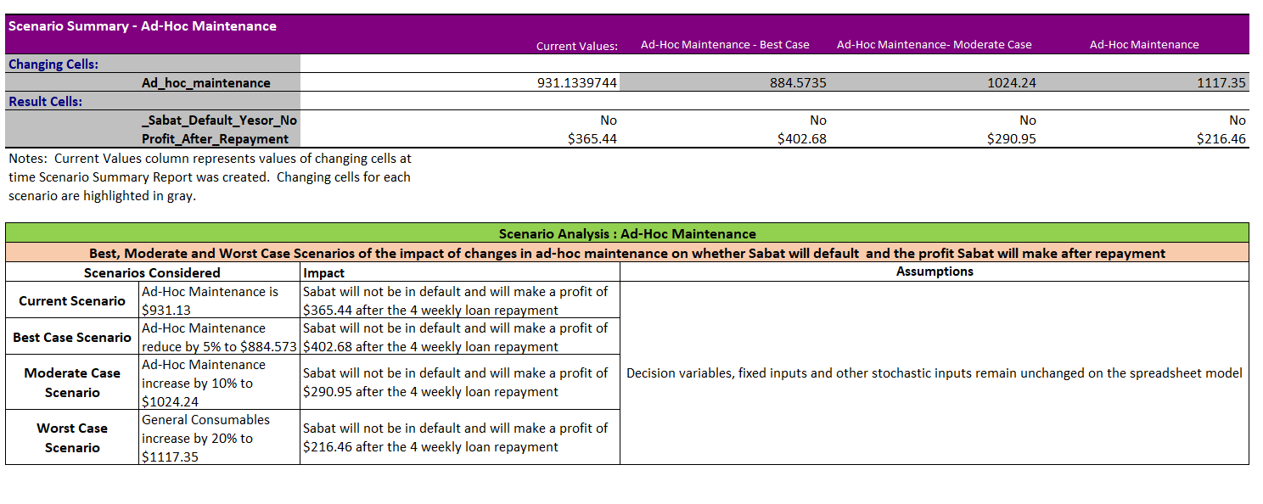
Scenario analysis

Slide 14
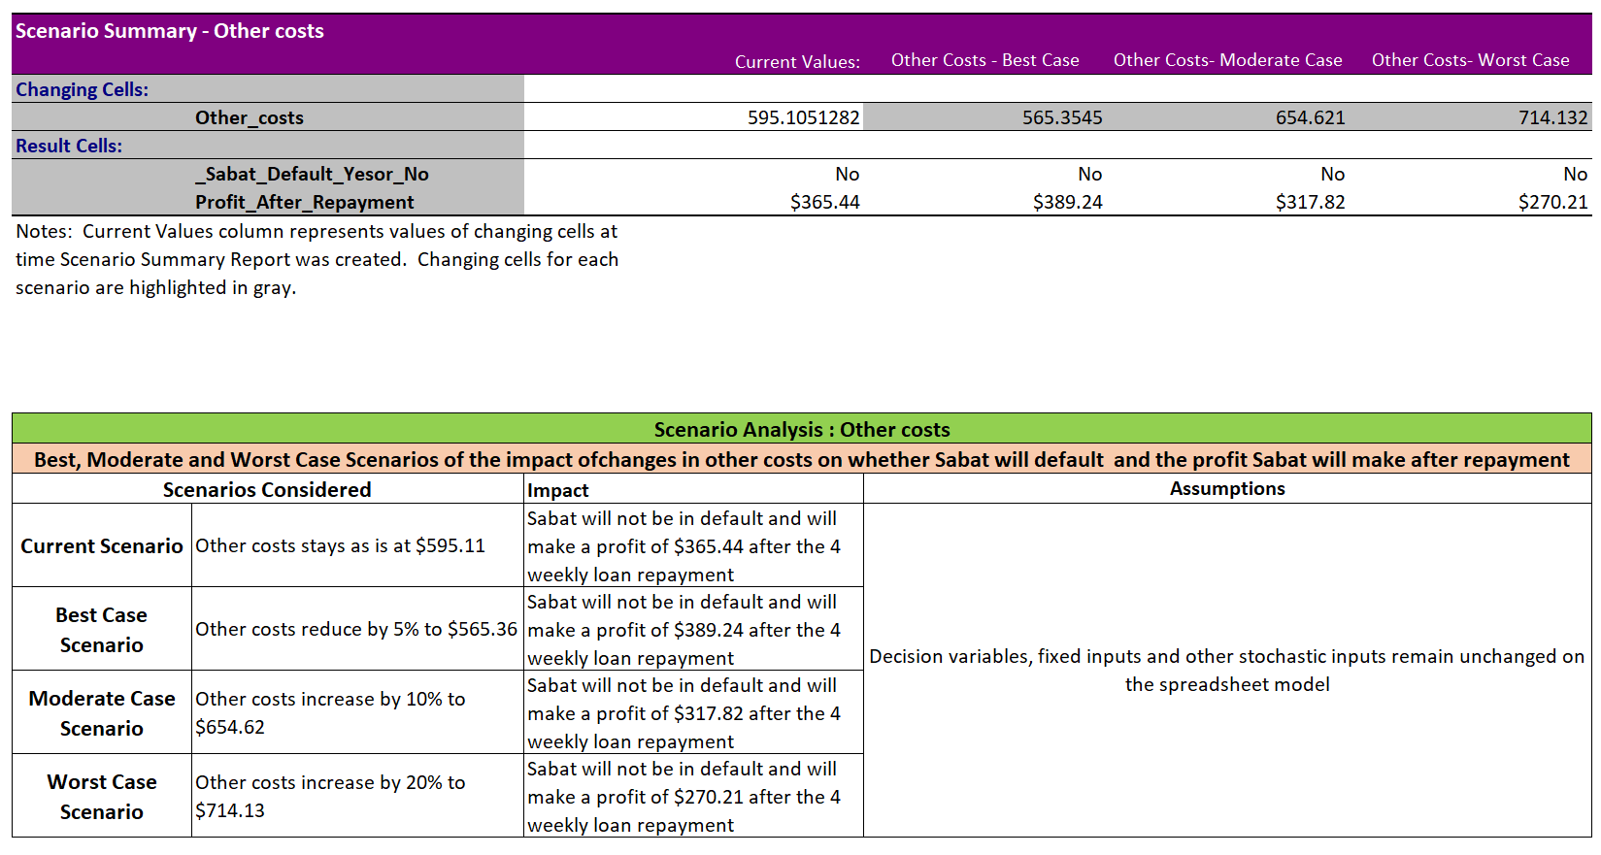
Scenario analysis

Slide 15
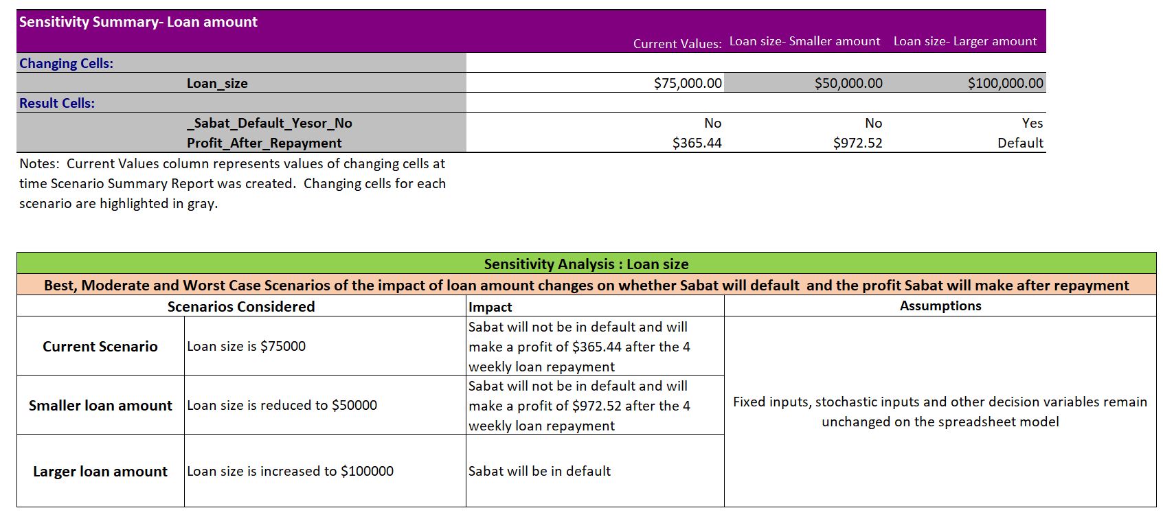
Sensitivity analysis

Slide 16
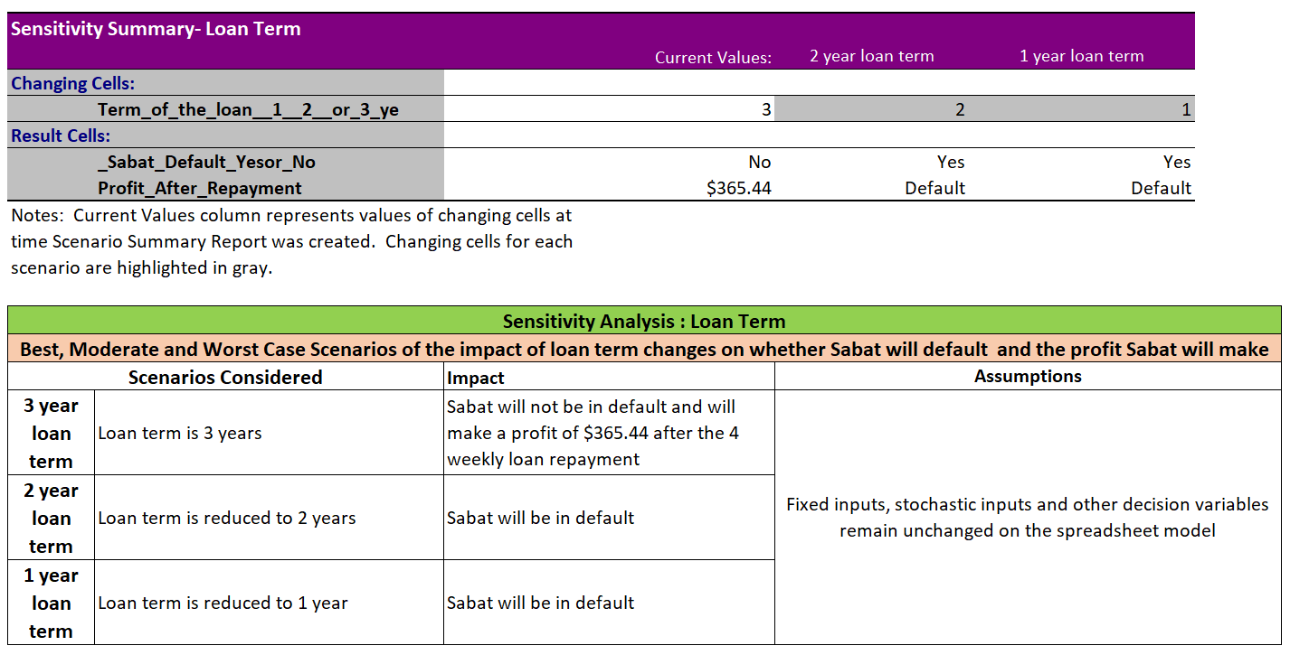
sensitivity analysis

Slide 17
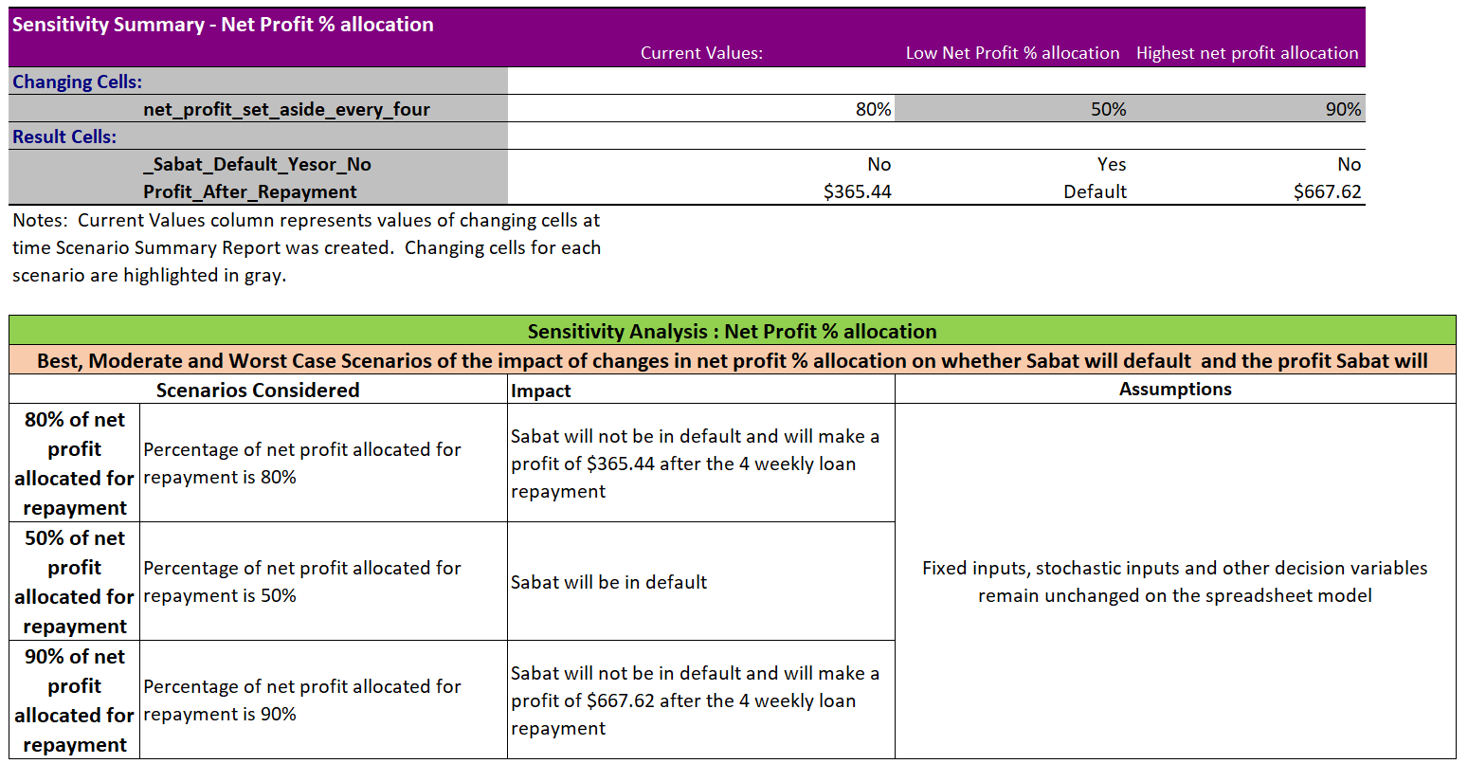
sensitivity analysis

Slide 18
sensitivity analysis- Overall Summary
Sensitivity analysis was conducted to measure the sensitivity of decision variables namely Loan size, Loan term (in years) as well as the percentage of net profit that would have to be set aside to make the 4 weekly repayment on whether Sabat will be in default of his loan.
Below is a summary table of when Sabat would not be in default
Loan Size | Loan Term in years | Percentage of net profit to be set aside set aside for repayment to be nt be in default | Sabat in Default Yes/No
$75000 | 3 | At least 80% | No
$75000 | 2 | At least 95% | No
$50000 | 2 | At least 67% | No
$50000 | 3 | At least 47% | No
$100000 | 3 | At least 88% | No

Slide 19
Input distributions - Baking Supplies- Normal Distribution

Slide 20
Input distributions- ad-hoc maintenance- uniform Distribution

Slide 21
Input distributions- general consumables - normal Distribution

Slide 22
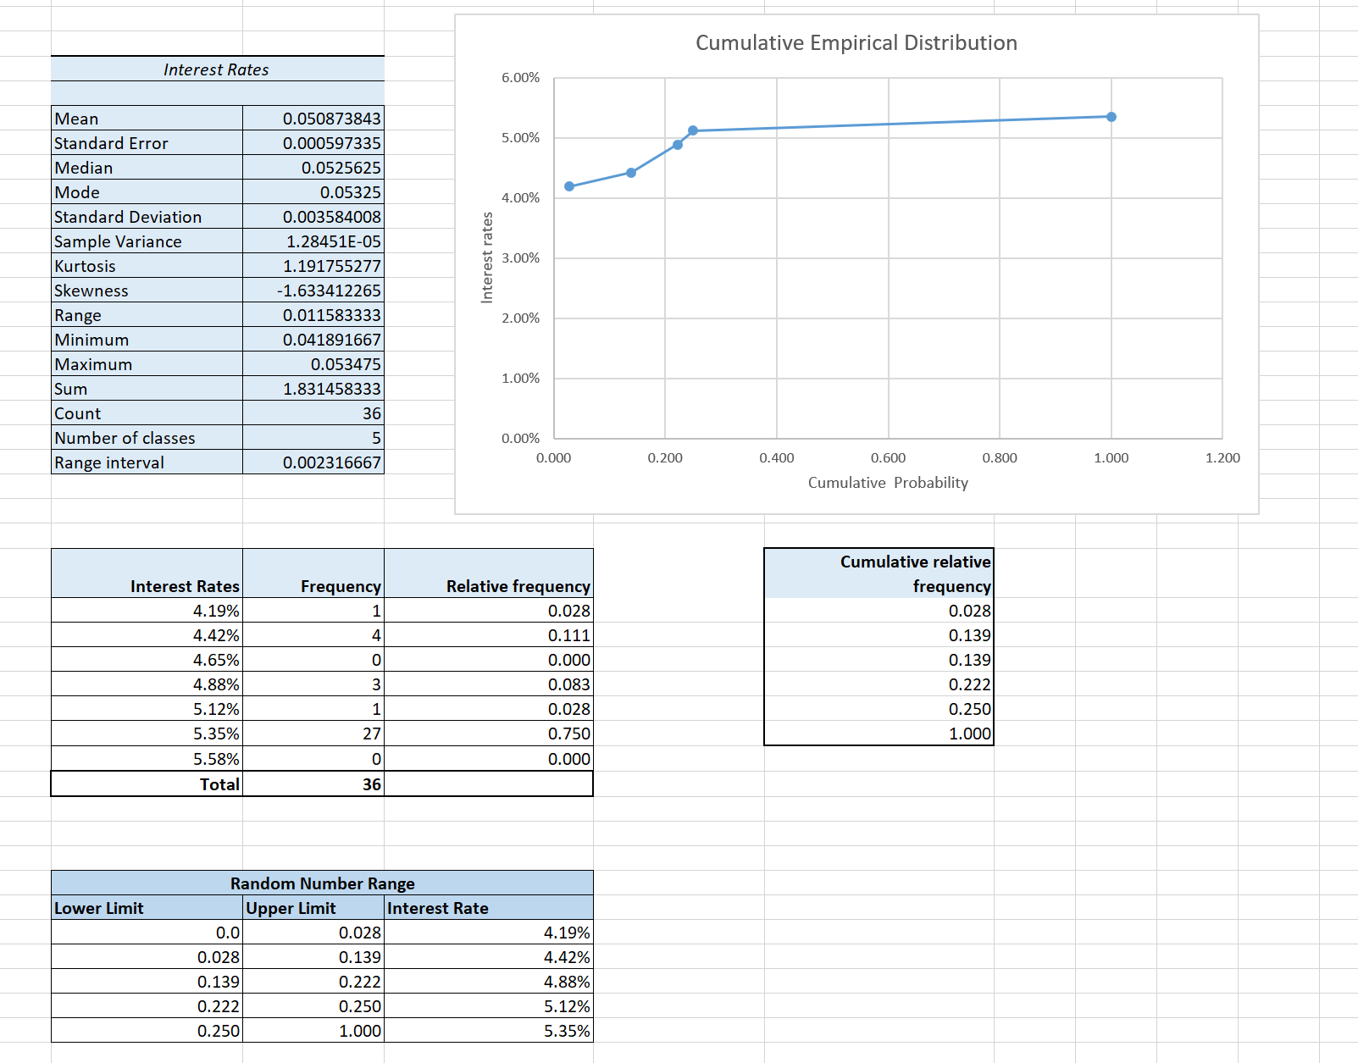
Input distributions- interest Rate - empirical Distribution
Based on the Random number range of cumulative relative frequencies (Random number range table on the left), the interest rates that have been established from the last 3 years of RBA fixed lending rates to small business will be used in the simulation model for interest rates which is a stochastic input

Slide 23
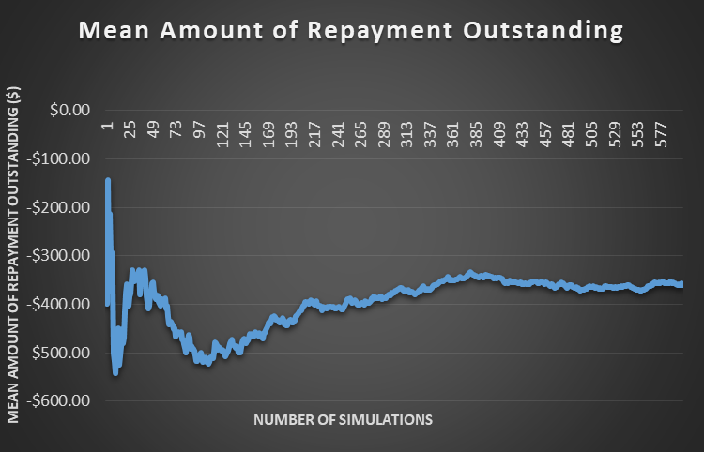
Simulated Output MEAN – Repayment outstanding
Simulated mean for output variable ‘Amount of Repayment Outstanding’ based on 600 simulations converges to a constant value of -359.92 dollars signifying that Sabat is making a net saving of 359.92 dollars on a 4-weekly basis on an average post repayment and is not in default for loan amount.
The graph on left hand side clearly shows that for lesser number of simulations, there is volatility in mean amount however it gets reduced on increasing number of simulations.

Slide 24
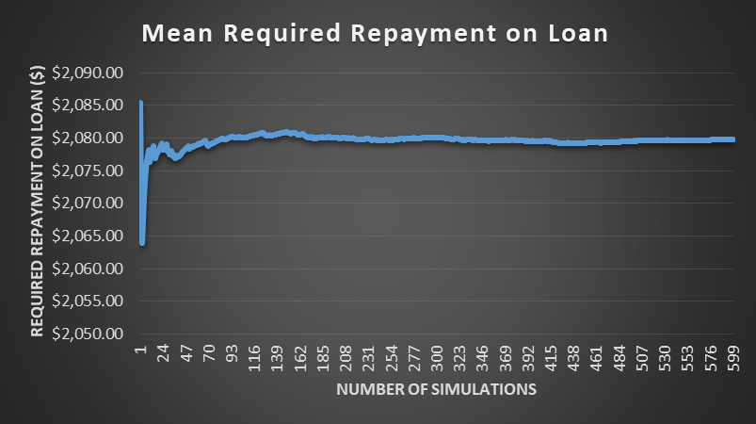
Simulated MEAN – Required Repayment oN Loan
Simulated mean for calculated variable ‘Required Repayment of Loan’ based on 600 simulations converges to a constant value of 2079.83 dollars signifying that Sabat is required to make a Repayment of 2079.83 dollars on an average.
The graph on left hand side clearly shows that for lesser number of simulations, there is volatility in mean Required Repayment amount however it gets greatly reduced on increasing number of simulations.

Slide 25
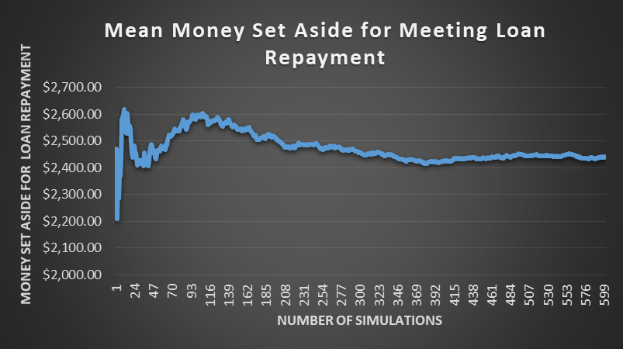
Simulated MEAN – money set aside for meeting loan repayment
Simulated mean for calculated variable ‘Money Set Aside for Loan Repayment’ based on 600 simulations converges to a constant value of 2439.75 dollars signifying that Sabat needs to set aside amount of 2439.75 dollars on an average for meeting loan repayment after every 4 weeks.
The graph on left hand side clearly shows that for lesser number of simulations, there is volatility in mean amount of money set aside however it gets greatly reduced on increasing number of simulations.

Slide 26
Descriptive statistics – simulated output – amount of Repayment outstanding
Descriptive statistics for simulated output ‘Amount of repayment outstanding’ shows that mean converges with the median and skewness and kurtosis coefficients are pretty close to zero signifying that distribution is symmetric.
Histogram of simulated output ‘Amount of repayment outstanding’ clearly shows that distribution is normal or bell shaped with mean of
-359.92 dollars and standard deviation of 777.42 dollars.

Slide 27
Descriptive statistics – simulated stochastic input – Interest rate per annum
Descriptive statistics for simulated stochastic input ‘Interest Rate per annum’ shows that mean is less than the median and skewness coefficient is -1.68 signifying that distribution is left skewed.
Histogram of simulated stochastic input ‘Interest Rate per annum’ clearly shows that distribution is left skewed with long left tail.
This is in line with assumed probability distribution of Interest Rate as empirical.

Slide 28
Descriptive statistics – simulated stochastic input – sales revenue
Descriptive statistics for simulated stochastic input ‘Sales Revenue’ shows that mean converges with the median and skewness and kurtosis coefficients are pretty close to zero signifying that distribution is symmetric.
Histogram of simulated stochastic input ‘Sales Revenue’ clearly shows that distribution is normal or bell shaped with mean of 51662.54 dollars for 4 weeks and standard deviation of 1023.36 dollars.
This is in line with fitted probability distribution of ‘Sales Revenue’ as normal.

Slide 29
Descriptive statistics – simulated stochastic input – coffee supplies
Descriptive statistics for simulated stochastic input ‘Coffee Supplies’ shows that mean converges with the median and skewness and kurtosis coefficients are pretty close to zero signifying that distribution is symmetric.
Histogram of simulated stochastic input ‘Coffee Supplies’ clearly shows that distribution is normal or bell shaped with mean of 2572.01 dollars for 4 weeks and standard deviation of 73.59 dollars.
This is in line with fitted probability distribution of ‘Coffee Supplies’ as normal.

Slide 30
Descriptive statistics – simulated stochastic input – baking supplies
Descriptive statistics for simulated stochastic input ‘Baking Supplies’ shows that mean converges with the median and skewness and kurtosis coefficients are pretty close to zero signifying that distribution is symmetric.
Histogram of simulated stochastic input ‘Baking Supplies’ clearly shows that distribution is normal or bell shaped with mean of 5159.11 dollars for 4 weeks and standard deviation of 117.5 dollars.
This is in line with fitted probability distribution of ‘Baking Supplies’ as normal.

Slide 31
Descriptive statistics – simulated stochastic input – general consumables
Descriptive statistics for simulated stochastic input ‘General Consumables’ shows that mean converges with the median and skewness and kurtosis coefficients are pretty close to zero signifying that distribution is symmetric.
Histogram of simulated stochastic input ‘General Consumables’ clearly shows that distribution is normal or bell shaped with mean of 2574.35 dollars for 4 weeks and standard deviation of 64.49 dollars.
This is in line with fitted probability distribution of ‘General Consumables’ as normal.

Slide 32
Descriptive statistics – simulated stochastic input – Ad hoc maintenance
Descriptive statistics for simulated stochastic input ‘Ad hoc maintenance’ shows that mean and median are pretty similar and skewness and kurtosis coefficients are close to zero signifying that distribution is symmetric. However, Standard Deviation is pretty high.
Histogram of simulated stochastic input ‘Ad hoc maintenance’ clearly shows that distribution is uniform in range of 600 dollars and 1560 dollars.
This is in line with fitted probability distribution of ‘Ad hoc maintenance’ as uniform.

Slide 33
Risk analysis – amount of repayment outstanding
Risk profiling for ‘Amount of repayment outstanding’ clearly depicts that Sales Revenue, Baking Supplies and Ad hoc maintenance costs drive the Repayment outstanding amount the most.
Higher mean sales revenue and higher mean baking supplies correspond to lesser Repayment outstanding amount.
Lower the mean ad hoc maintenance cost, lesser is the Repayment outstanding amount.

Slide 34
Risk analysis – required repayment on loan
Risk Profiling for 'Required repayment on loan' indicates that mean interest rate per annum drives the required repayment of loan with higher interest rate corresponding to higher required repayment on loan.
All other stochastic inputs are not impacted by varying the Required Repayment on Loan.

Slide 35
Risk analysis – money set aside for meeting loan repayment
Risk profiling for ‘Amount of repayment outstanding’ clearly depicts that Sales Revenue, Baking Supplies and Ad hoc maintenance cost drive the calculated variable ‘Money set aside for loan repayment’ the most.
Higher mean sales revenue and higher mean baking supplies correspond to higher money set aside for loan repayment.
Lower the ad hoc maintenance cost, higher is the money set aside for meeting loan repayment.

Slide 36
THANK YOU

